Slide 1

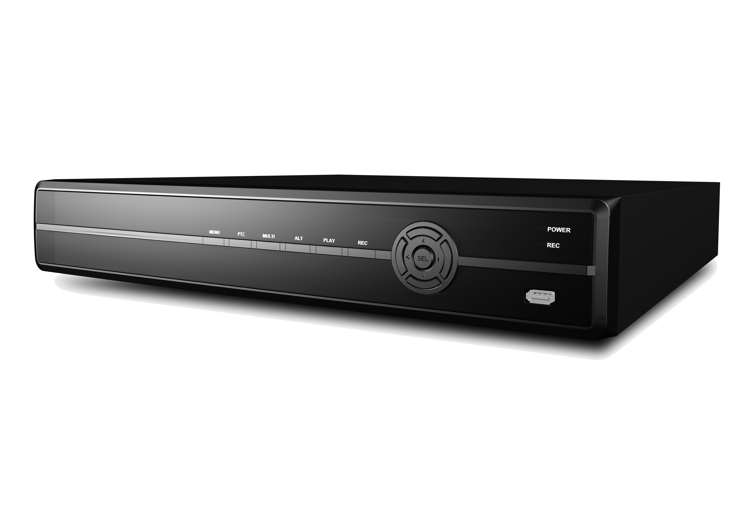
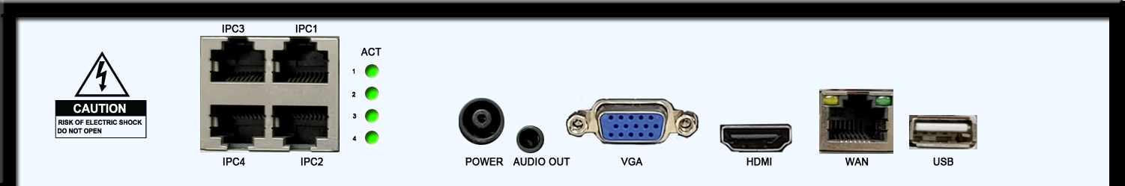
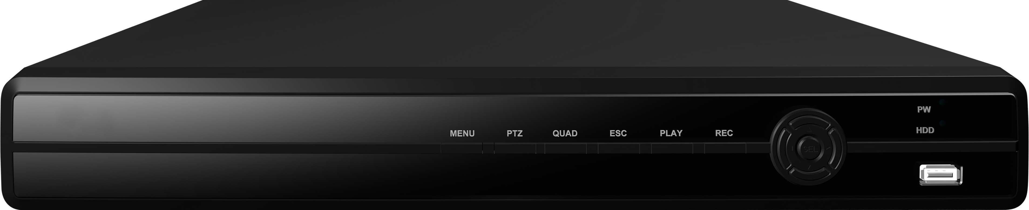
JNR-400
H.265 Compact 4CH P.O.E NVR
MODEL |  | JNR-400
DISPLAY
Live | Resolution | 1024x768 / 1920x1080
 | Display Mode | 1, 4
 | Digital Zoom | Up to x7
INTERFACE
Video In | IP CAM Input | 4
 | POE | 4
Video Out | HDMI | 1
 | VGA | 1
 | Composite | -
Audio | Input (protocol) | Onvif profile S
 | Output | 2 (HDMI/RCA)
Interface | USB 2.0 | 2
 | PTZ control (protocol) | Onvif profile S
 | E-SATA | -
 | Ethernet | 4x10/100(POE) + 1 (WAN)
 | Sensor Input | -
 | Alarm Output | -
 | SATA | 1 x SATA HDD (Max. 6TB)
PERFORMANCE
Compression Algorithm |  | Video : H.264/H.265, Audio : G726
Operating System |  | Embedded Linux
Multi-Operation |  | Live, Recording, Playback, Backup, Network
Recording | Recording Resolution | CIF~5M
 | Recording Bandwidth | Up to 24Mbps
 | Event recording | Onvif protocol (Basic notification & Pull point)
 | Mode | Manual / Continuous / Schedule / Motion / Sensor & Pre/Post, Panic
 | Pre-recording | 0~5sec
 | Post-recording | 0~120sec
Playback | Search | Search by Time, Calendar , Events, Panoram First/Last Search
 | Speed | 1x, 2x, 4x, 8x, 32x, 128x
Backup | Backup Device | USB Memory Stick/HDD, Backup by Network
 | Backup File Format | AVI (With or Without Timestamp) PS (Playback in Backup-Viewer)
Events & Alarm |  | Email & FTP Notification/ Alarm-out / Buzzer for Events & Video Loss
 |  | Warning Message & Buzzer for HDD Over-Temperature
Network | Transmission | Video Dual-Stream (Local recording & Network Transmission)
 |  | Bandwidth adjustable (64/128/256/512Kbps, 1/2/4/10Mbps, Unlimited)
 | Netclient/Web(I.E.) | Live , Playback, Backup , PTZ, DVR Setup
 | Mobile Viewer | Supported by Android OS, iOS(Iphone)
GENERAL
Power |  | DC48V / 2 A
Storage temperature & humidity |  | -20~60 ℃ / 20~95% RH
Operating temperature & humidity |  | 5~40 ℃ / 20~80% RH
Dimension (W x D x H) |  | 254 X 210 X 42 mm
Weight |  | Appx. 0.7 kg
H.265
Key Features
Up to 5Megapixel supported
24 Mbps network camera recording
P.O.E and Plug & play
Onvif profile S/T
Edit the profiles of IP camera
Compatible with Max. 6TB HDD
HDMI
Smart phone support
CMS software for NVRs management
Dimension
Unit : mm
254
210
42
*Specification is subject to change without prior notice
REVISED 12-2021

